Slide 1
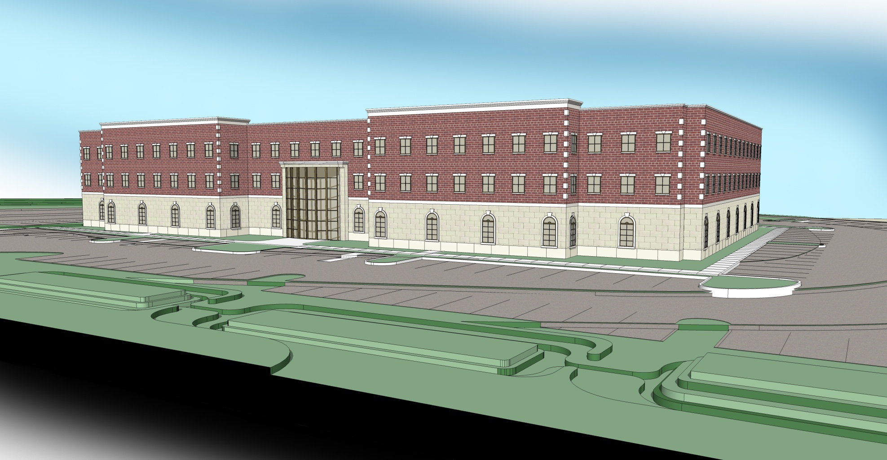
Crocker West Building
State College, Pa
Eric M. Foster
Spring 2009
Structural Option

Slide 2
Outline
Overview of Existing
Proposal
Structural Depth Study
Architectural Breadth Study
Construction Management Breadth Study
Summary/Conclusions
Acknowledgements
???
Eric M. Foster
Crocker West Building
Structural Option

Slide 3
Overview of Existing
Location
  224 Science Park Road
  State College, Pa
Eric M. Foster
Crocker West Building
Structural Option

Slide 4
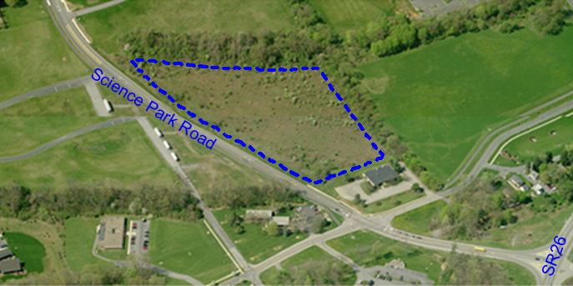
Overview of Existing
Location
  224 Science Park Road
  State College, Pa
  Just of SR 26 in Ferguson Township
Eric M. Foster
Crocker West Building
Structural Option

Slide 5
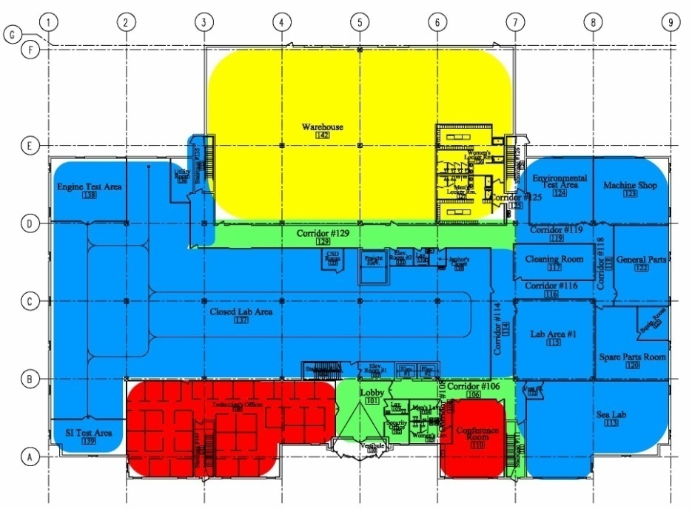
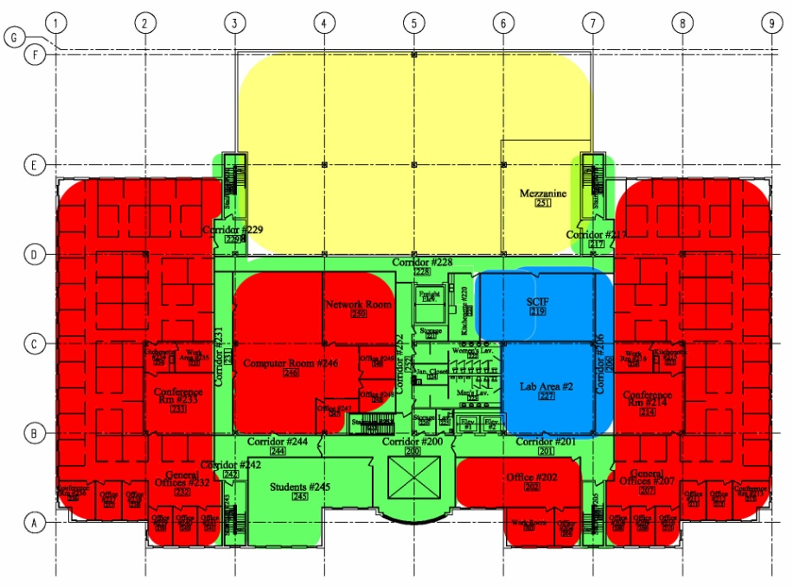
Overview of Existing
Location
Use
  40,000 s.f. Light Industrial
  70,000 s.f. Office
  10,000 s.f. Warehouse Storage
Eric M. Foster
Crocker West Building
Structural Option

Slide 6
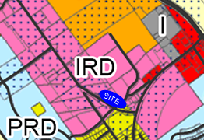
Overview of Existing
Location
Use
Zoning
  Light Industry, R & D
Eric M. Foster
Crocker West Building
Structural Option

Slide 7
Overview of Existing
Location
Use
Zoning
Owners
  C2S, LLP. (Scott Smith & Mike Coyle)
Eric M. Foster
Crocker West Building
Structural Option

Slide 8

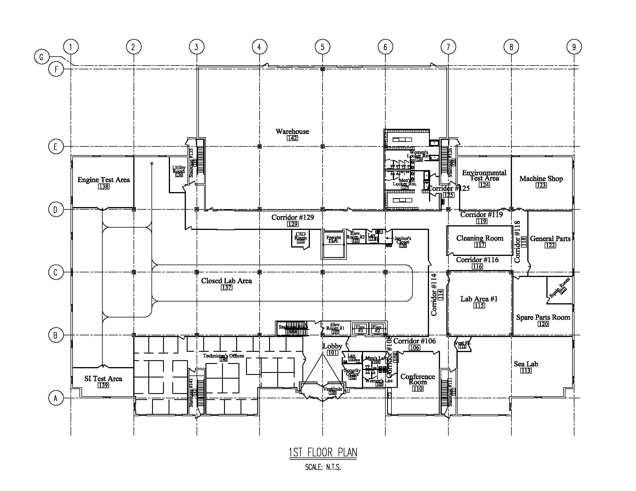
Overview of Existing
Location
Use
Zoning
Owners
Size
  3-Story Low-Rise Building (45 ft)
  121,000 s.f.
Eric M. Foster
Crocker West Building
Structural Option

Slide 9
Overview of Existing
Location
Use
Zoning
Owners
Size
Cost
  Approximately $18 Million
Eric M. Foster
Crocker West Building
Structural Option

Slide 10
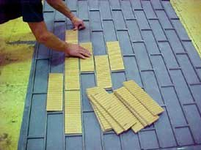
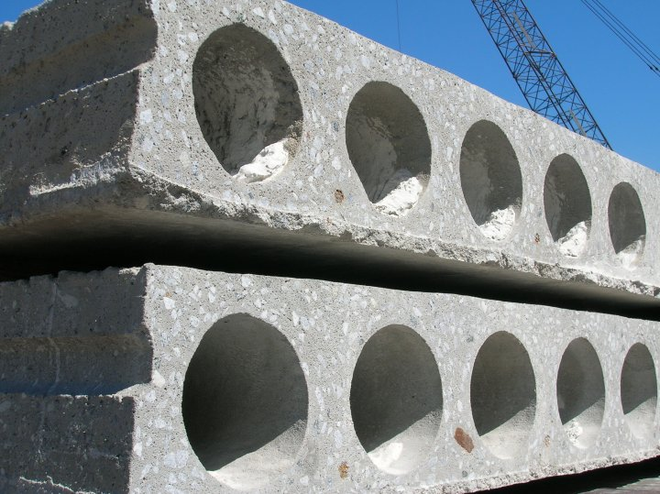
Overview of Existing
Architectural Precast Concrete (APC)
  Columns (24 in square columns)
  Wall Panels (9 ½” & 12 ½” Thk. Insulated Panels)
    Brick In-lay Finish
  Inverted Tee (IT) Beams (18”-28” Deep)
  4 ft wide Hollow-Core Plank (8”-12” Thk.)
Eric M. Foster
Crocker West Building
Structural Option

Slide 11
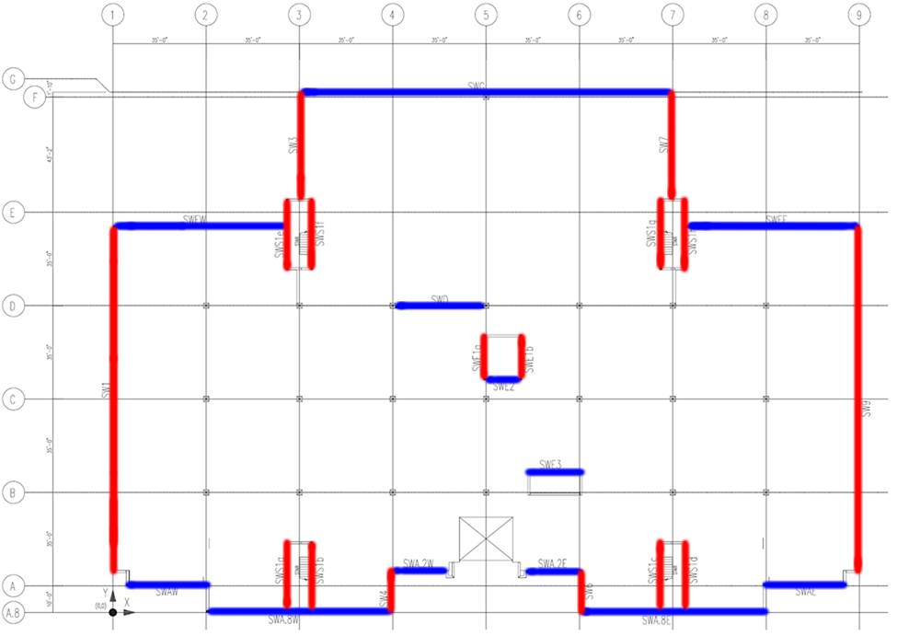
Overview of Existing
Architectural Precast Concrete (APC)
Lateral System
  APC Shear Walls
Eric M. Foster
Crocker West Building
Structural Option

Slide 12
Outline
Overview of Existing
Proposal
Structural Depth Study
Architectural Breadth Study
Construction Management Breadth Study
Summary/Conclusions
Acknowledgements
???
Eric M. Foster
Crocker West Building
Structural Option

Slide 13
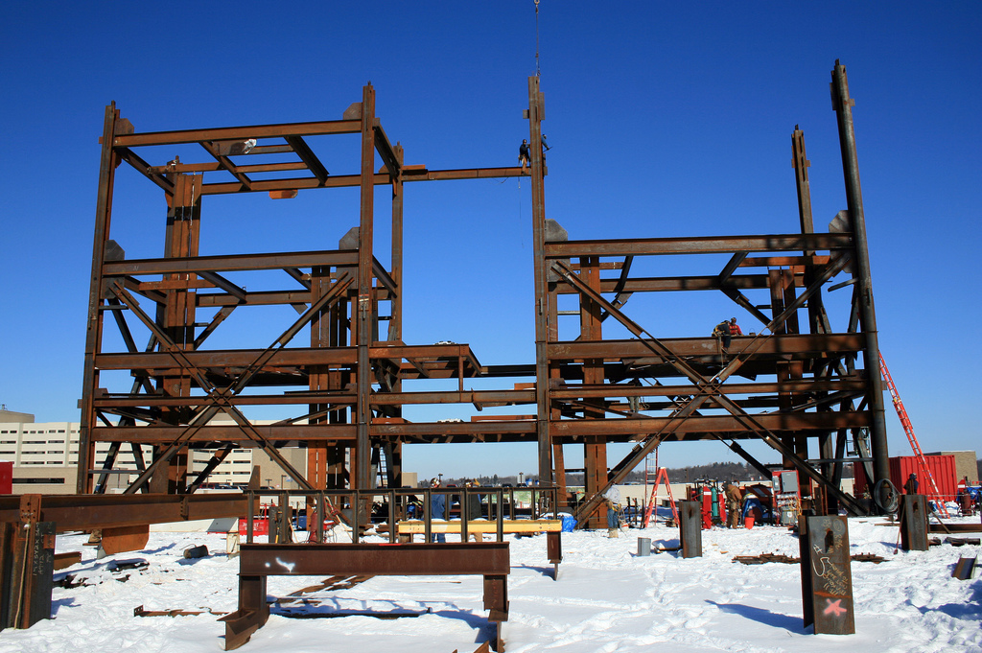
Proposal
Structural Depth Study
  Request of Additional 3-Stories for Office Space
  Redesign using Composite Steel Framing utilizing Concentrically Braced Frames (CBF) for Lateral
Eric M. Foster
Crocker West Building
Structural Option

Slide 14
Proposal
Structural Depth Study
Architectural Breadth Study
  Ramifications of Additional 3-Stories to Architectural Program and Overall Exterior Vision
Construction Management Breadth Study
  Relative Cost Comparison of Different Framing Systems
Eric M. Foster
Crocker West Building
Structural Option

Slide 15
Outline
Overview of Existing
Proposal
Structural Depth Study
Architectural Breadth Study
Construction Management Breadth Study
Summary/Conclusions
Acknowledgements
???
Eric M. Foster
Crocker West Building
Structural Option

Slide 16
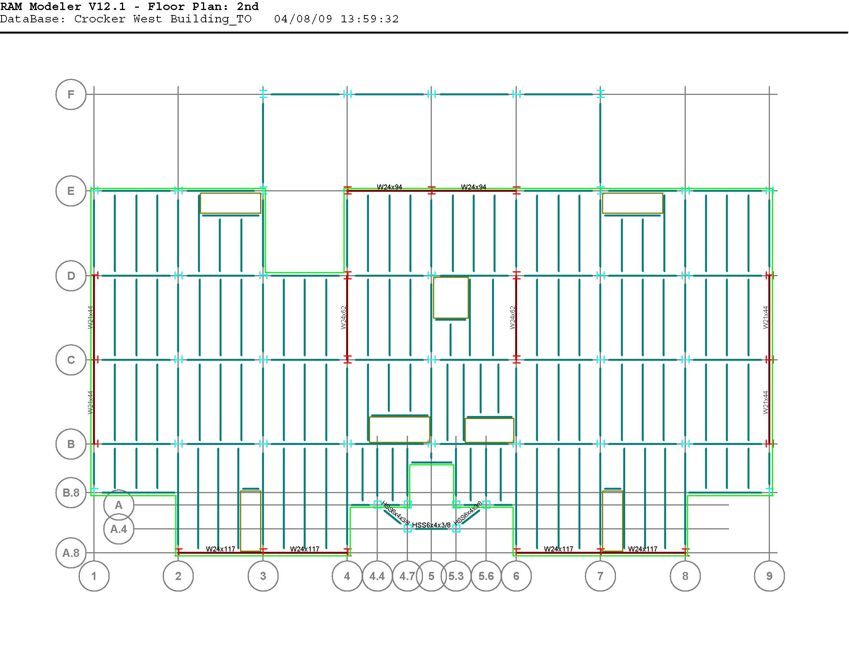
Structural Depth Study
Existing Floor System
  APC Hollow-Core Plank System
Proposed Composite Floor System
  3” USD Metal Deck w/ 3” L.W.C.
Eric M. Foster
Crocker West Building
Structural Option

Slide 17
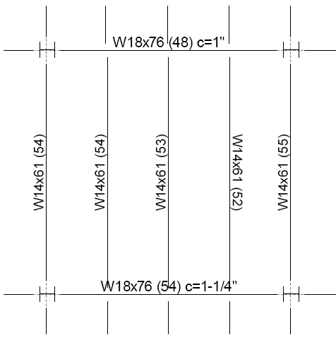
Structural Depth Study
In-fill Beams
  W14x61
Girders
  W18x76
Columns
  Range from W12x40 to W14x211
Eric M. Foster
Crocker West Building
Structural Option

Slide 18
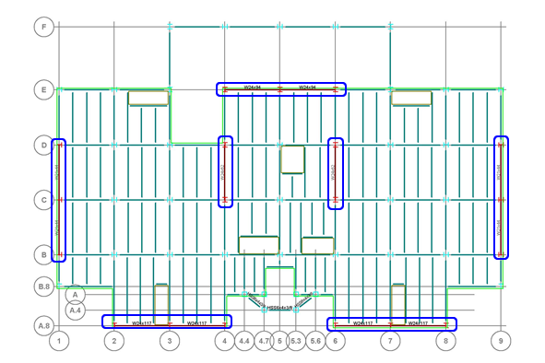
Structural Depth Study
Existing Lateral System
  APC Shear Walls
Proposed Lateral System
  Concentrically Braced Frames (CBF)
Eric M. Foster
Crocker West Building
Structural Option

Slide 19
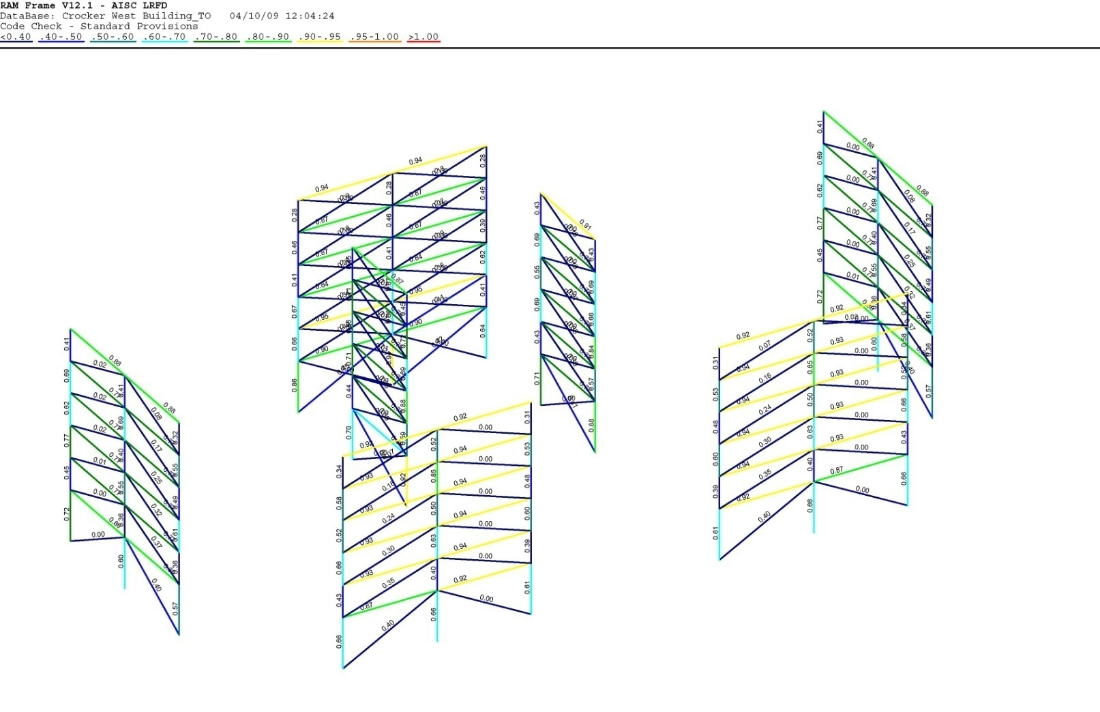
Structural Depth Study
Lateral Framing
  Total of Seven (7) CBF’s
  HSS Bracing Utilized
  Symmetrical Layout Hinders Torsional Irregularities
RAM
  Used to Analyze and Design
  Drift, Story Drift, Torsion included in Design Checks
Eric M. Foster
Crocker West Building
Structural Option

Slide 20
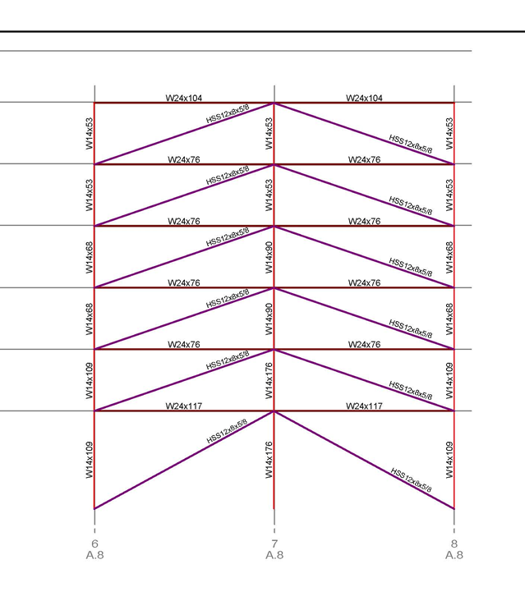
Structural Depth Study
Bracing
  HSS used for all CBF’s
  HSS 12 x 8 x 5/8” typical size
Eric M. Foster
Crocker West Building
Structural Option

Slide 21
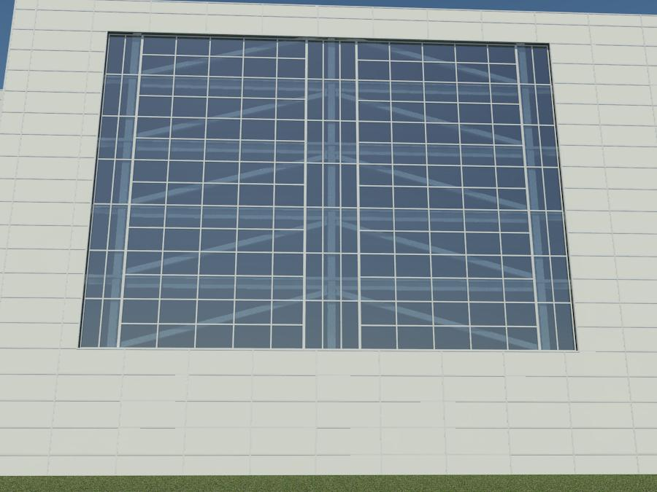
Structural Depth Study
CBF Pro’s & Con’s
  Easy Installation/Fast Erection Time
  Cheaper than Moment Frames
  Bracing Alters Program Requirements
Architectural Function
  Used to accentuate exterior views by exposing CBF
Eric M. Foster
Crocker West Building
Structural Option

Slide 22
Outline
Overview of Existing
Proposal
Structural Depth Study
Architectural Breadth Study
Construction Management Breadth Study
Summary/Conclusions
Acknowledgements
???
Eric M. Foster
Crocker West Building
Structural Option

Slide 23
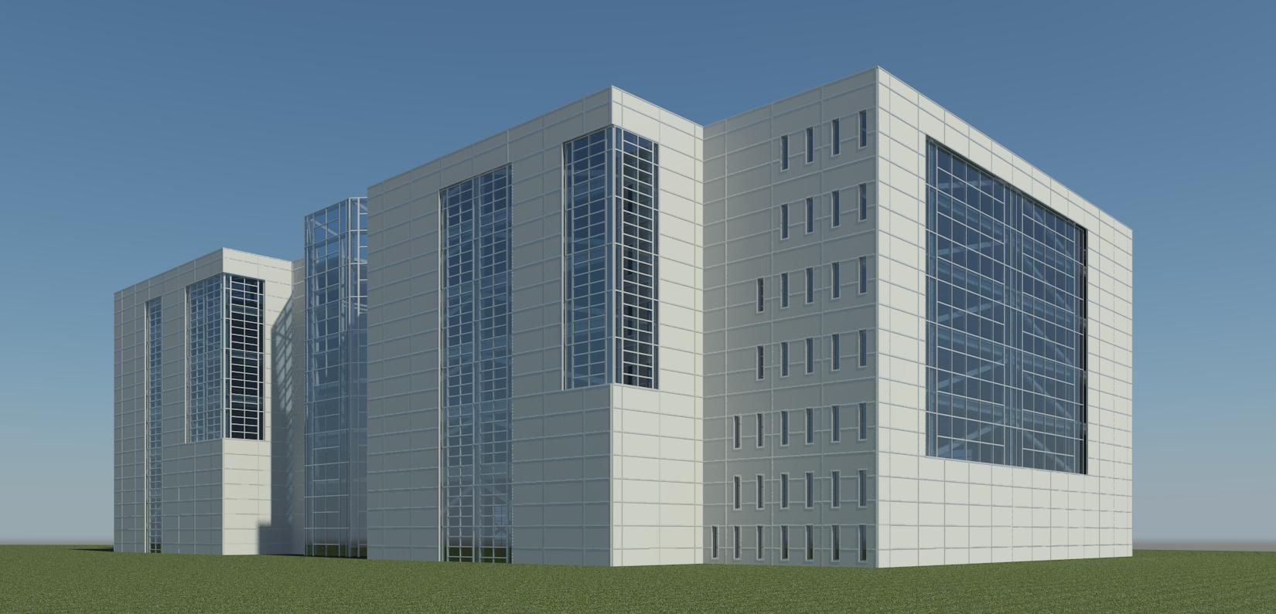
Architectural Breadth Study
3-D Modeling
  Building Information Modeling (BIM)
  Autodesk Revit Architecture
Architecture
  New Exterior Façade introduces New Style of Architecture to surrounding area
Eric M. Foster
Crocker West Building
Structural Option

Slide 24
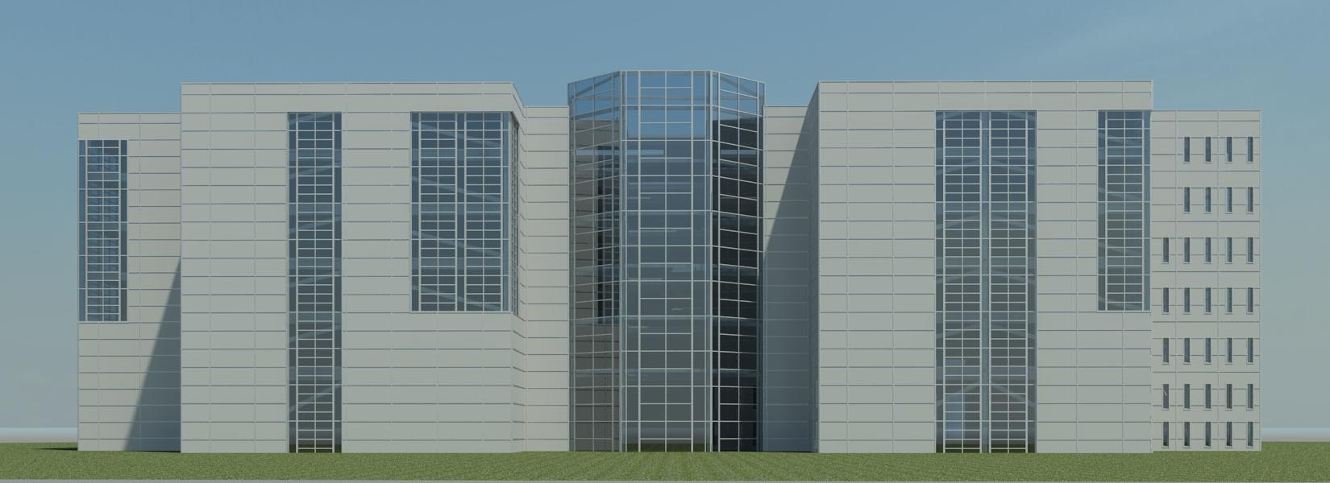
Architectural Breadth Study
Additional 3-Stories
  Nearly Doubles Existing Height (79 ft Mean Roof Ht.)
  APC Height Limitations
Facade
  Metal Panel w/ Glazing In-fill
  Glass Curtain Walls
Eric M. Foster
Crocker West Building
Structural Option

Slide 25
Outline
Overview of Existing
Proposal
Structural Depth Study
Architectural Breadth Study
Construction Management Breadth Study
Summary/Conclusions
Acknowledgements
???
Eric M. Foster
Crocker West Building
Structural Option

Slide 26
CM Breadth Study
Cost
  APC cost estimated $3.95 Million
  Steel cost estimated $3.1 Million
Schedule
  Similar Erection Times (APC vs. Steel)
  Façade could prove to be largest difference between systems
  13 month schedule would be difficult to beat
Eric M. Foster
Crocker West Building
Structural Option

Slide 27
Outline
Overview of Existing
Proposal
Structural Depth Study
Architectural Breadth Study
Construction Management Breadth Study
Summary/Conclusions
Acknowledgements
???
Eric M. Foster
Crocker West Building
Structural Option

Slide 28
Summary/Conclusions
Structural
  Steel Proved Viable
  CBF Later System Design limits serviceability issues
  Seismic Weight Reduced by switching to steel
Architectural
  New Architectural Style to surrounding area
  Maintained Overall Architectural Program
Construction Management
  Cost and Schedule Comparable
Eric M. Foster
Crocker West Building
Structural Option

Slide 29
Outline
Overview of Existing
Proposal
Structural Depth Study
Architectural Breadth Study
Construction Management Breadth Study
Summary/Conclusions
Acknowledgements
???
Eric M. Foster
Crocker West Building
Structural Option

Slide 30
Acknowledgements
Scott Smith and Scott Smeal of
Civilsmith Engineering, Inc.
Mike Coyle of Northwestern Mutual Financial
Mike Evanko of Evanko-Renwick Engineering
AE Faculty and Staff
On-line Mentors
ALL MY FAMILY and FRIENDS
Eric M. Foster
Crocker West Building
Structural Option

Slide 31
Thank You!
Eric M. Foster
Crocker West Building
Structural Option

Slide 32
Questions
???
Eric M. Foster
Crocker West Building
Structural Option

